Slide 1
OAMP 2021 AGM
Wednesday November 3, 2021
Virtual Meeting

Slide 2
OAMP 2021 AGM Agenda
Call to Order
Approval of the previous minutes
President’s Report – Joe Hayward
Ontario Red-Tape Reduction Strategy – Nicholas Shkumat
Treasurer’s Report - Crystal Angers
Membership Report – Jeff Richer
Elections and Introduction of the new board – Stephen Breen
Adjournment

Slide 3
OAMP Executive - current
President: Joseph E. Hayward
Vice-President: Brian Keller
Past President: Stephen Breen
Secretary: Jeffrey Richer
Treasurer: Crystal Angers
Members-at-Large: Jenna King, Nicholas Shkumat, Anthony Kim

Slide 4
Disclaimer
there has been much speculation regarding regulation for medical physicists in Ontario
the OAMP Executive made the decision to seek external advice from an external agency
Counsel Public Affairs
  Counsel is one of Canada’s leading public affairs agencies, specializing in government relations, strategic communications, and integrated campaigns.

Slide 5
Stolen and Adapted from JFK Inaugural Address, 1961
Ask not what medical physics can do for you, ask what you can do for medical physics.

Slide 6
Counsel
Medical Physicists in Ontario
Evaluating and Charting a Path Forward
for Self-Regulation

Slide 7
Counsel Report: Deliverables
A review of the status of professional self-regulation for Medical Physicists in relevant Canadian and international jurisdictions;
Key informant interviews;
Consideration of the existing health professions regulatory framework in Ontario, including an assessment of the profession in regard to the significant regulatory requirements under the Regulated Health Professions Act (RHPA);
An analytical overview of the current strategic political, policy, and fiscal/economic environments impacting professional self-regulation in Ontario; and
Evaluation of alternative options for professional self-regulation.

Slide 8
Counsel Report – Excerpt from Executive Summary
It can be a lengthy and costly initiative with no guarantees of ultimate success, particularly under the RHPA framework. Under either scenario identified below, the decision to grant professional self-regulation is ultimately a political one, and will require sustained engagement by OAMP and consultant partners with an evolving number of officials and staff who will be called upon to make key decisions throughout the process.

Slide 9
Examining Medical Physicists Against the RHPA Professional Self-Regulation Criteria
Risk of Harm High
Professional Autonomy High
Educational Requirements for Entry to Practice High
Body of Knowledge and Scope of Practice High
Economic Impact of Regulation Low
Regulatory Mechanisms Medium
Leadership’s Ability to Favour the Public Interest,
Membership Support,
Willingness of the Profession to be regulated Low
Health System Impact Medium

Slide 10
Emerging Trends in Ontario
The reform of professional self-regulation in BC has attracted significant attention from other provincial regulators across Canada. Ontario is no exception.
  While the Ontario Government has not taken any concrete steps to begin or signal its intention to pursue substantial reform of professional self- regulation, specifically for health professions, there is nevertheless interest within the Ministry of Health.
  The Ministry of Health is developing a College Performance Measurement Framework (CPMF), which Ontario’s 26 regulatory health colleges are expected to implement and report to the ministry on accountability, public trust, performance improvement and modernization of the workforce.
  Once implemented, CPMF will provide the Ministry of Health with detailed information on the performance of the regulatory health colleges, which may be used in assessing any proposed regulatory reforms on consolidation of colleges.
  Given the McMaster Health Forum evaluations of 2017 and 2019, the ongoing Ministry of Health CPMF initiative, and the British Columbia government’s 2020 plan to overhaul its health regulatory system, one should anticipate that post-pandemic Ontario may move forward with an effort to reform its own system.

Slide 11
Phase 1–Intelligence Gathering
This would include the implementation of a focused engagement plan with key decision-makers and staff within the Ministry of Health and other relevant offices, and would be intended to provide both Counsel and OAMP with additional clarity prior to embarking on a more extensive government relations effort regardless of the proposed option.
Estimated duration: 3 months
Estimated total cost (excluding taxes and administrative fees): $12,000 ($4,000 monthly
retainer)

Slide 12
Phase 2 – Direct Advocacy and Policy Support
Ongoing direct advocacy with targeted elected officials, political staff and civil service officials in the Ministry of Health and across the Ontario government;
Policy development support and strategic advice;
Government relations advocacy training, activation and coordination for OAMP leadership and members;
Identification, engagement and mobilization of supportive third-party stakeholders;
Development of supporting materials and key messages;
Regular meetings/conference calls with OAMP leadership and designated representatives;
Oversight and management of the execution of the government relations action plan.

Slide 13
Counsel’s Recommended Scenarios
Scenario A – Professional Self-Regulation under the RHPA
Estimated duration:4–6years
Estimated monthly cost (excluding taxes and administrative fees):
$8,500–$12,000 monthly retainer
Scenario B – Legislated Title Protection / Regulations under the OHFDA
Estimated duration:2–3years
Estimated monthly cost (excluding taxes and administrative fees):
$6,500–$9,500 monthly retainer

Slide 14
So What’s Next?
the OAMP Executive is soliciting comments and concerns from the measurement
send all comments to info@oamponline.net

Slide 15
HARPA HAPPENINGS
Brief summary of expert-panels, task forces, and associated reports
Status of HARPA and its potential replacement, 2017’s “Oversight of Health Facilities and Devices Act” (Schedule 9, Bill 160)
Review of 2021’s public consultations on HARPA and the proposed regulatory amendment to Reg. 543 s.3 (2)

Slide 16

Recent History
2015-07
HQO Commissioned the “Expert Panel to Enhance the Safety and Quality of Energy-Applying Medical Devices in Ontario”
Mandate
“To provide recommendations / advice to Health Quality Ontario (HQO) on the modernization of the Healing Arts Radiation Protection Act (HARP Act) in order to:
Enhance patient, provider and public safety in energy-based imaging and therapeutic modalities, contemplating risk for general use, therapeutic use, and use with vulnerable (e.g., pediatric) populations; and,
Promote quality in their application to medical practice.”

Slide 17
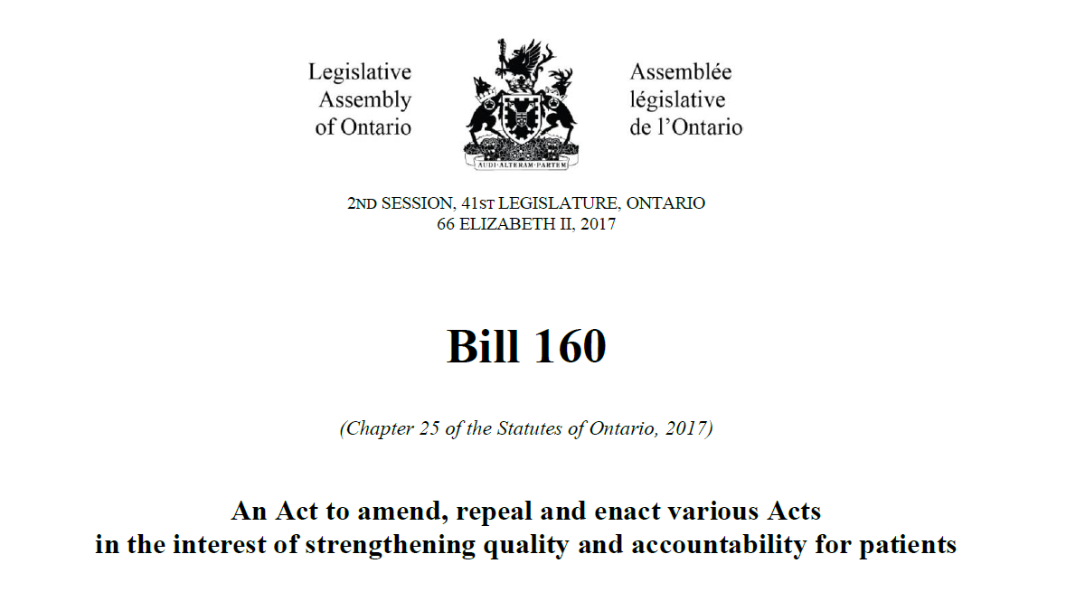
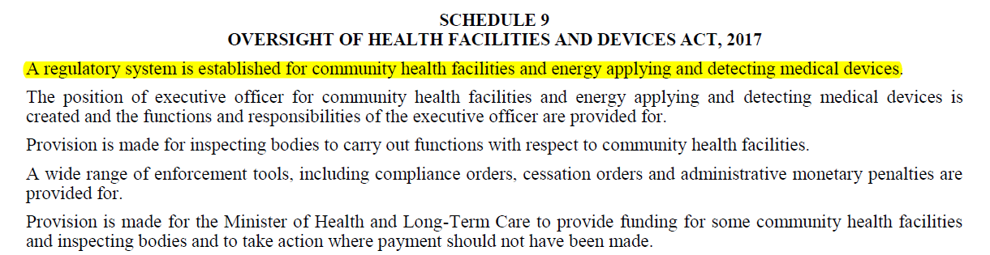
Recent History
As of Nov. 2021, this Act has yet to be enacted
2017-12
Prior to its passing, previous and current OAMP board members attended public consultations at Queen’s Park (I. Yeung and N. Shkumat )

Slide 18
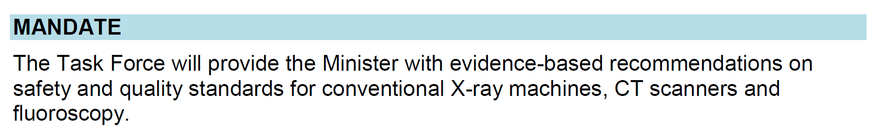
Recent History
2018-01
MOHLTC (now MOH) Commissioned the “Task Force for the Development of Standards for X-rays”
12 members (including an OAMP director)
2019-04
A draft final report was completed but not published nor made available to the public. . .

Slide 19
Current Events
2021-04
Government announced new “red tape and burden reduction measures” to minimize barriers on businesses
commitment to enhance HARPA to “better enable innovation and the use of new and emerging technology”
MOH solicited “technical and radiation safety experts, technology users, and sector industry representatives” for legislative/regulatory amendments that:
can be implemented within the existing HARPA framework;
are within the scope of the government
do not compromise safety/quality standards
2021-06

Slide 20
Current Events
2021-07
MOH convened a panel of “Sector Experts” to review the submissions received from members of the public, manufacturers, and associations
5 “sector experts” participated (including an OAMP director)
2021-10
Following consultation, MOH revealed 4 targeted actions
Modernizing shielding design methods
  HARPA Reg. 543 s.3 (2)
  Replace SC20A with SC35 for shielding methodology
  Allowing for adoption of NCRP Report 147
    Report 49 may still be used

Slide 21
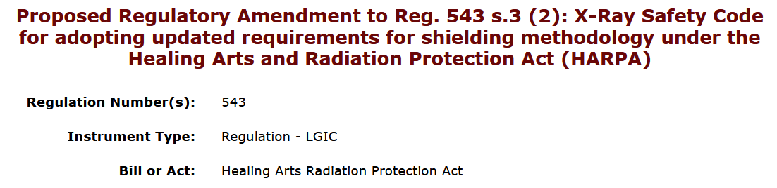
Current Events
2021-10
Following consultation, MOH revealed 4 targeted actions
Modernizing shielding design methods
  Proposal: 21-HLTC021
  Comments due: November 22, 2021
“No later than July 1, 2022”
https://www.ontariocanada.com/registry/view.do?postingId=39127&language=en

Slide 22
Current Events
2021-10
Following consultation, MOH revealed 4 targeted actions
Provide guidance re: CT designation process
  certainty for approval timelines
  reduction in the approval timeline by 60%
  create a streamlined application for replacement CTs
Clarify definitions surrounding “owners” and “operators”
  new guidance document to provide clarification regarding the responsibility of operating devices for demonstration purposes
Clarify guidance documentation regarding floor plan submission requirements for mobile devices
“Fall 2021”

Slide 23
Financial Report
HIGHLIGHTS:
OAMP membership has been declining slightly since 2019
Due to consulting fees we ran a significant deficit in 2020. Fortunately this was adequately covered by our surplus.
The 2020 income tax was submitted in June.
A $5000 GIC was purchased in 2019

Slide 24
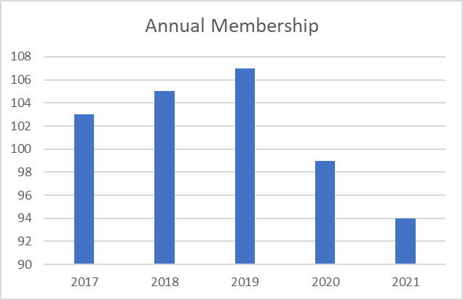
OAMP Membership
2020: 2 student/retiree members and 97 full members (no Corporate members)
2021: 4 student/retiree members and 90 full members (no Corporate members)

Slide 25
Annual Income Statement

Slide 26
Balance Sheet

Slide 27
Annual Independent Audit (vote)
“As per the Ontario Corporations Act, an annual audit is required for not-for-profit corporations with an annual income greater than $100,000. The OAMP will not meet this requirement in the foreseeable future. Thus OAMP will forego an annual audit unless requested by the membership by a consensus vote at the annual general meeting.”

Slide 28
Membership Report
As previously stated, OAMP membership has been declining slightly since 2019
Sources – OAMP membership database, COMP Professional Survey and COMP directory

Slide 29
OAMP Board of Directors
President | Dr. Joe Hayward | 2022* | acclaimed
Vice-President | Dr. Brian Keller | 2022* | acclaimed
Secretary | Mr. Jeff Richer | 2022 | appointed (By-law 2.07.4)
Treasurer | Dr. Tim Olding | 2025* | acclaimed
Director-at-Large | Dr. Tony Kim | 2022 | elected
Director-at-Large | Mr. Nick Shkumat | 2022* | elected
Director-at-Large | Ms. Jenna King | 2022 | elected
Director-at-Large | Ms. Crystal Plume Angers | 2022 | appointed (By-law 2.07.4)
Past-President | Dr. Stephen Breen | 2022 | appointed (By-law 2.01)

