Slide 1
OAMP 2022 AGM
Wednesday, September 14, 2022
Virtual Meeting

Slide 2
OAMP 2022 AGM Agenda
Call to Order
Approval of the previous minutes
President’s Report – Joseph E. Hayward
Treasurer’s Report - Tim Oldfield
Membership Report – Jeff Richer
Other Business – Joseph E. Hayward
Educational Session
Technical Standards Committee
Other
Elections and Introduction of the New Board – Stephen Breen
Adjournment

Slide 3
OAMP Executive - Current
President: Joseph E. Hayward
Vice-President: Brian Keller
Past President: Stephen Breen
Secretary: Jeffrey Richer
Treasurer: Tim Oldfield
Members-at-Large: Jenna King, Nicholas Shkumat, Anthony Kim
Special Advisor: Crystal Angers

Slide 4
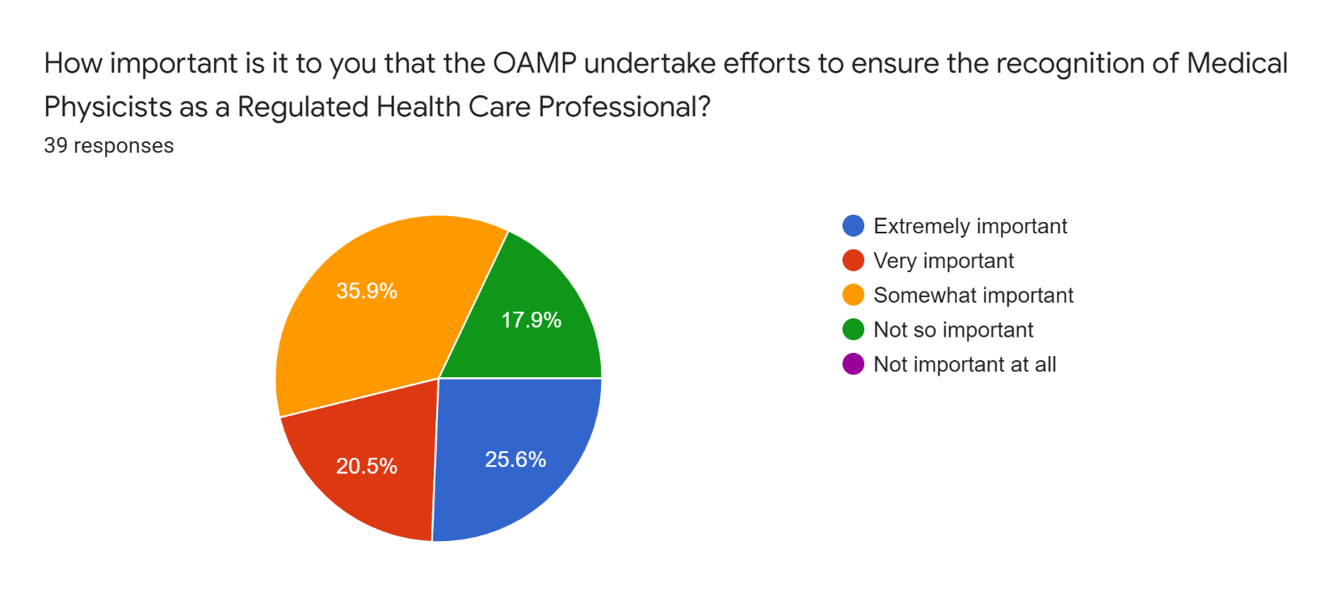
2022 OAMP Survey Results

Slide 5
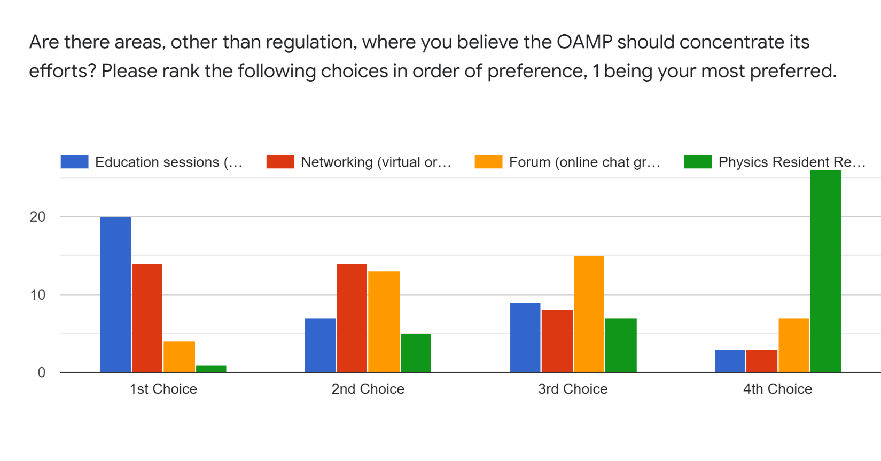
2022 OAMP Survey Results

Slide 6
Financial Report
HIGHLIGHTS:
OAMP membership has been declining since 2019
The 2021 income tax was submitted in May. The Notice of Assessment was received in June without issue.

Slide 7
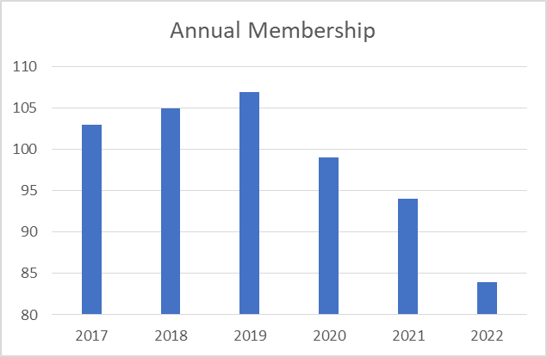
OAMP Membership
2020: 2 student/retiree members and 97 full members (no Corporate members)
2021: 4 student/retiree members and 90 full members (no Corporate members)
2022: 1 student/retiree members and 84 full members (no Corporate members)

Slide 8
Annual Income Statement

Slide 9
Balance Sheet

Slide 10
Annual Independent Audit (vote)
“As per the Ontario Corporations Act, an annual audit is required for not-for-profit corporations with an annual income greater than $100,000. The OAMP will not meet this requirement in the foreseeable future. Thus OAMP will forego an annual audit unless requested by the membership by a consensus vote at the annual general meeting.”

Slide 11
Membership Report
As previously stated, OAMP membership has been declining slightly since 2019
Sources – OAMP membership database, COMP Professional Survey and COMP directory

Slide 12
OAMP Board of Directors
President | Dr Esmaeel Ghasroddashti | 2025 | acclaimed
Vice-President | Dr. Brian Keller | 2025 | acclaimed
Treasurer | Dr. Tim Olding | 2024 | acclaimed
Director-at-Large | Dr. Katie S. Lekx-Toniolo | 2025 | acclaimed
Director-at-Large | Mr. Nick Shkumat | 2022*
Director-at-Large | Mr. Luc Serre | 2025
Past-President | Dr. Joseph E. Hayward | 2025 | appointed (By-law 2.01)

