Slide 1
OAMP 2023 AGM
Wednesday, November 8, 2023
Virtual Meeting

Slide 2
OAMP Executive - Current
President: Joseph E. Hayward
Vice-President: Brian Keller
Past President: Vacant
Secretary: Nicholas Shkumat
Treasurer: Tim Olding
Members-at-Large: Katie Lekx-Toniolo, Luc Serre

Slide 3
OAMP 2023 AGM Agenda
Call to Order
Approval of the previous minutes
President’s Report – Joseph E. Hayward
Treasurer’s Report - Tim Olding
Membership Report – Tim Olding
Elections and Introduction of the New Board – Joseph E. Hayward
Other Business – Brian Keller
Adjournment

Slide 4
Financial Report
HIGHLIGHTS:
The 2022 income tax was submitted in May. The Notice of Assessment was received in July without issue.

Slide 5
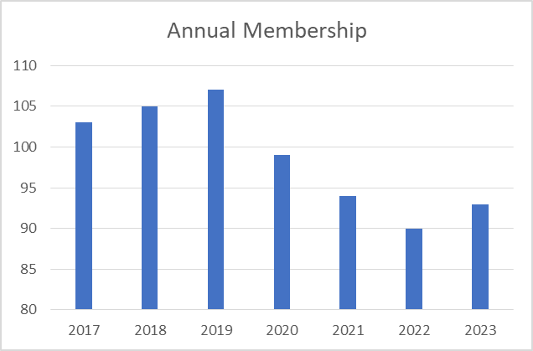
OAMP Membership
2020: 2 student/retiree members and 97 full members (no Corporate members)
2021: 4 student/retiree members and 89 full members (no Corporate members)
2022: 1 student/retiree members and 89 full members (no Corporate members)
2023: 9 student/retiree members and 84 full members (no Corporate members)

Slide 6
Annual Income Statement

Slide 7
Balance Sheet

Slide 8
Annual Independent Audit (vote)
“As per the Ontario Corporations Act, an annual audit is required for not-for-profit corporations with an annual income greater than $100,000. The OAMP will not meet this requirement in the foreseeable future. Thus OAMP will forego an annual audit unless requested by the membership by a consensus vote at the annual general meeting.”

Slide 9
OAMP Board of Directors
President | Dr. Brian Keller | 2025 | Acclaimed
Vice-President | Dr. Katie Lekx-Toniolo | 2025 | Acclaimed
Past President Treasurer Secretary | Dr. Joseph E. Hayward Dr. Tim Olding Mr. Nick Shkumat | 2026 2024 2024 | Per Policy Acclaimed Acclaimed
Director-at-Large | Mr. Luc Serre | 2025 | Acclaimed
Director-at-Large | Vacant | 2025
Director-at-Large | Vacant | 2025

Slide 10
Initiatives
OAMP to maintain itself as the medical physics voice for the Ontario government legislation.
OAMP to monitor professional regulation across Canada and consider moving forward on it for Ontario medical physicists if it looks good to do so and if membership votes positively on it.
OAMP to gather salary data in support of its union and non unionized membership to compare with wages across Canada
OAMP to hold education sessions on relevant topics that may have impact

