Slide 1
OAMP 2024 AGM
Wednesday, January 29, 2025
Virtual Meeting

Slide 2
OAMP Board of Directors - Current
President: Brian Keller
Vice-President: Katie Lekx-Toniolo
Past President: Joseph Hayward
Secretary: Nicholas Shkumat
Treasurer: Tim Olding
Members-at-Large: Luc Serre

Slide 3
OAMP 2024 AGM Agenda
Call to Order
Approval of the previous minutes
President’s Report – Brian Keller
Regulation Update – Joe Hayward
Treasurer’s Report - Tim Olding
Membership Report – Tim Olding
Elections and Introduction of the New Board – Nick Schkumat/ Brian Keller
Adjournment

Slide 4
President’s Report
- Education and networking sessions
    - Delivered 3 sessions. Plan to continue
- Engagement of student membership
    - Reached out to medical physics graduate schools
    - Regulation update
- There were 6 Board of Director meetings since last AGM.

Slide 5
Regulation of Medical Physicists

Slide 6
Advantages
Protection of the Ontario Public
Scope of Practice Legislated
Credibility (possible salary increases)
Ability to incorporate
More letters behind your name

Slide 7
Disadvantages
Cost
Time
May need to sit a Code of Ethics examination

Slide 8
OAMP Initiatives
Task Force created to look at this issue (volunteers needed)
Possible creation of Professional Scientists of Ontario (PSO)
Modeled after PEO
Outreach to other interested parties (CAP showing interest)

Slide 9
Financial Report
HIGHLIGHTS:
The 2023 income tax was submitted in May. The Notice of Assessment was received in July without issue.
A five year term GIC held by OAMP (enabling a corporate credit card) was renewed in Nov 20, 2024 for another five years (3.3%)

Slide 10
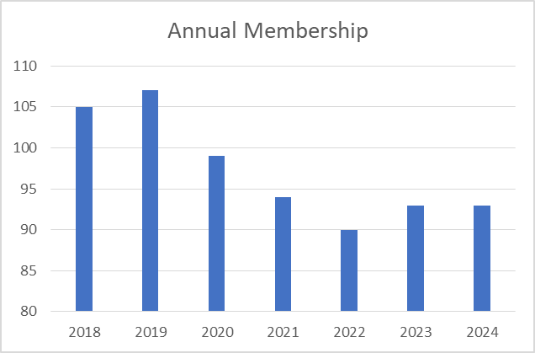
OAMP Membership
2020: 2 student/retiree members and 97 full members (no Corporate members)
2021: 4 student/retiree members and 89 full members (no Corporate members)
2022: 1 student/retiree members and 89 full members (no Corporate members)
2023: 8 student/retiree members and 85 full members (no Corporate members)

Slide 11
Annual Income Statement

Slide 12
Balance Sheet

Slide 13
Annual Independent Audit (vote)
“As per the Ontario Corporations Act, an annual audit is required for not-for-profit corporations with an annual income greater than $100,000. The OAMP will not meet this requirement in the foreseeable future. Thus OAMP will forego an annual audit unless requested by the membership by a consensus vote at the annual general meeting.”

Slide 14
OAMP Board of Directors
President | Brian Keller | 2025 | Acclaimed
Vice-President | Katie Lekx-Toniolo | 2025 | Acclaimed
Past President Treasurer Secretary | Joseph E. Hayward Tim Olding Nick Shkumat | 2025 2027 2025 | Appointed Acclaimed Acclaimed
Director-at-Large | Luc Serre | 2025 | Acclaimed
Director-at-Large | Malcolm McEwen | 2028 | Acclaimed
(3) Director-at-Large | Vacant | 2025

